Slide 1
Making Partnerships and Collaboration Happen!
Laurie Jo Wallace, MA
Health Resources in Action
July 20, 2016

Slide 2
Agenda for Presentation
Sustainability: Successful Partnerships
  Types
  Steps, Questions and Examples
Barriers to Collaboration
  Fears and Experiences
  Drivers of Successful Collaboration
Cross-sector partnership problem -solving
  Exercise: Collaboration Web
  Choose a problem: focus- “a target group you need to engage”
  Fill in web
  Share back/Larger group discussion on collaboration exercise
Leveraging resources and connections

Slide 3
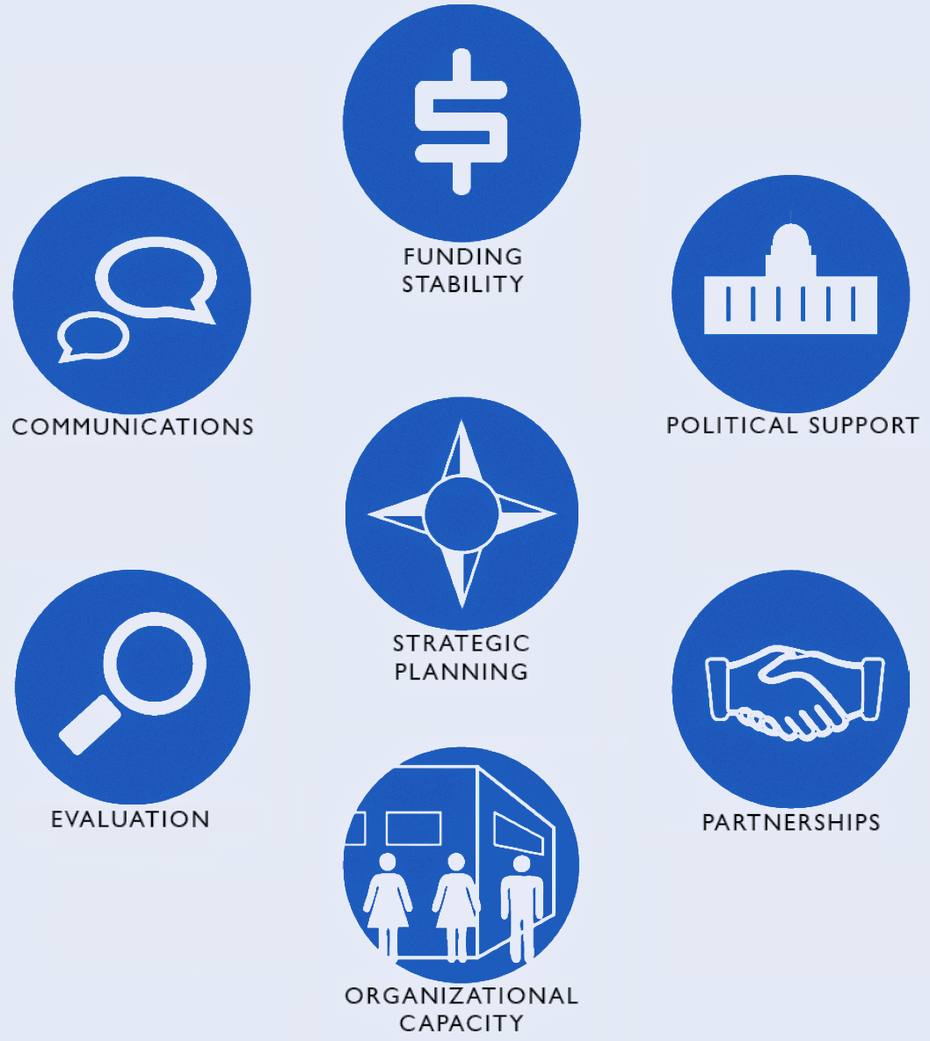
Elements of Coalition Sustainability
Notes:
Intro:
Health Resources in Action (HRiA) proposes to lead the Statewide Technical Assistance Support Services for Prevention Programs (STASSPP) to address the needs of:
BSAS-funded and other substance abuse prevention coalitions, including the 31 Underage Drinking and 15 MassCALL2 coalitions,;nongeographic populations (including Native Americans, Military families and LGBTQ communities); municipalities; and Boards of Health.
provide training and technical assistance (T/TA) to MA communities in applying the strategic prevention framework (SPF) to select and implement evidence-based strategies to prevent use and related consequences of alcohol, tobacco and other drugs.
HRiA will: respond to coalition needs; proactively provide T/TA on SPF, CC and sustainability; engage diverse community sectors and subpopulations including youth, Native Americans, military families and LGBTQ; facilitate collaboration, coaching and resource sharing; and use communication technologies for outreach, community buy-in, and dissemination.
A STASSPP Action Institute will be created with 4 components: SPF, Implementation/Sustainability, Mentoring, and Youth, supported by a state-of-the-art website with e-modules, webinars, resources, blogs, etc., to bolster inter-coalition work within tiered Learning Communities along with ongoing individual RPC support. STASSPP will host a Statewide Action Institute Kick-off, quarterly regional meetings, and annual end-of-year Best Practices Action Institutes.
HRiA’s STASSPP team collectively possesses: profound understanding of the SPF; proven T/TA track record; clearly aligned resources and expertise; firm community, regional and statewide relationships; and ability to implement STASSPP immediately.

Slide 4
Elements of Sustainability
Organizational Capacity
  Recruiting, engaging and retaining members/new leaders
  Creating sound organizational structure
Strategic Planning
  Turning vision and mission into effective and sustainable action
Communication/Marketing: cultivating buy-in; Building support visibility
Diverse Resources/Funding Streams
  Identifying/leveraging diverse funding streams
  Cultivating in-kind (material, human) resources
Partnerships: Integrating efforts; collaborating with other stakeholders
Community Champions: Cultivating community support
Evaluation/Program Improvement: Assessing/reflecting on process and outcome measures

Slide 5
Partnerships
Partnerships vary in their complexity, intensity, and formality. The broader the scope of the problem and the longer the projected lifetime of the partnership, the more complex, tightly linked, and formal a partnership should be. More limited and short‐term partnerships may require a less formal, less complicated approach.

Slide 6
Types of Partnerships
Networking – provides a forum for the exchange of ideas and information for mutual benefit, often through newsletters, conferences, meetings and electronic information sharing. It is one of the least formal forms of partnership and requires little time or trust between partners.
Coordinating – involves exchanging information and altering activities for a common purpose.

Slide 7
Types of Partnerships- Part 2
Cooperating – involves exchanging information, altering activities and sharing resources. It requires a significant amount of time, high level of trust, and sharing of turf.
Collaborating – includes enhancing the capacity of the other partner for mutual benefit and a common purpose, in addition to the above activities.

Slide 8
Partnerships: Steps and Questions to Consider
What other efforts are happening in your community? Are you linked to these efforts? How?
What key groups/organizations do you need to recruit to accomplish your efforts? Why?
Who are the key groups/organizations invested in the success of your efforts?
Are you supporting other community efforts? Why? Why not?
Are there other opportunities for collaboration?

Slide 9
Barriers to Partnerships : Lack of Trust and Control
Unclear, unrealistic, and/or vague goals
Costs to members exceed benefits
Responsibility without authority
Top down external mandates
Unrealistic timeframes for success
Lack of trust and time

Slide 10
Drivers for Successful Partnerships
Mutual Understanding
Securing Trust: No partnership can be successful without trust.
Clarity of Goals
Finding Champions
Sharing Data
Ensuring Mutual Benefit
Insuring Productivity

Slide 11
Trust + Clarity of Goal = Successful Partnerships
Planning
Agriculture/Food Systems
Economic Development
Public Safety
Businesses
Policy Law-Makers
Racial/Cultural
Schools
Youth/Students
Multi-Sector
Partnerships
Parks/Recreation
Faith Communities
Elders/Seniors
Government/Elected Officials
Health Care
Immigrant/Refugees
Transportation

Slide 12
Trust + Clarity of Goal = Successful Partnerships
 |  |  | ORGANIZATIONAL SECTOR ("X" in sector; can X more than one box) |  |  |  |  |  |  |  |  |  | ENGAGE | LEVEL
Organization/Individual | Key contact | Role/ Title | Business | Hospital/ Health Care | Commty Orgs | Gov’t | Youth | Funder/Fdtns | Housing | School/Univ | Faith | Racial/ Ethnic/ Language | Already engaged in another initiative? | Priority level (1,2,3)

Slide 13
Thanks!
Contact :
Laurie Jo Wallace, MA; ljwallace@hria.org
Health Resources in Action
Resource: Community Health Partnerships Tools and Information for Development and Support (Developed by the National Business Coalition on Health and the Community Coalitions Health Institute with support from a Cooperative Agreement with the Centers for Disease Control and Prevention, the Association of State and Territorial Health Officials, and the National Association of City and County Health Officials)

